Slide 1
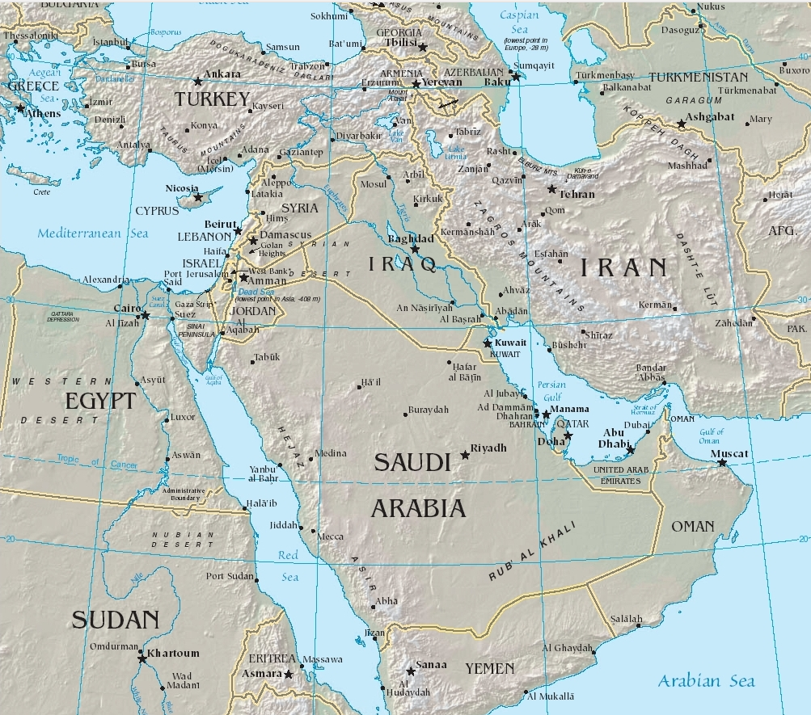
See page for author, Public domain, via Wikimedia Commons
wikimedia.org/wikipedia/commons/1/13/Middle_east.jpg

Slide 2
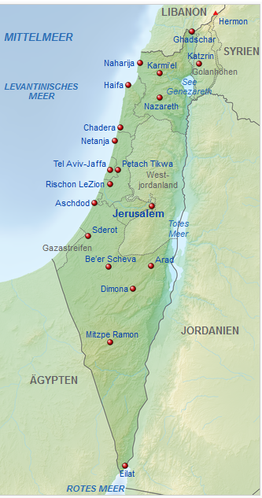
Tschubby, CC BY-SA 3.0 creativecommons by-sa 3.0 , via Wikimedia Commons

Slide 3
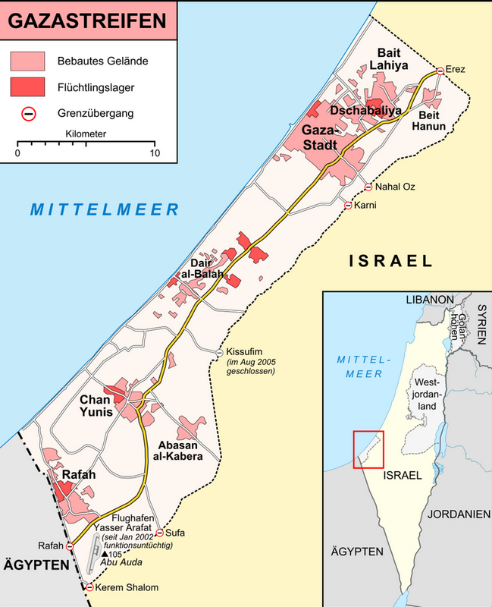
Lencer, CC BY-SA 3.0 <https://creativecommons.org/licenses/by-sa/3.0>, via Wikimedia Commons
https://de.wikipedia.org/wiki/Gazastreifen

Slide 4
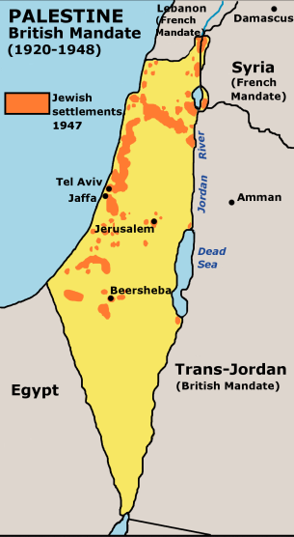
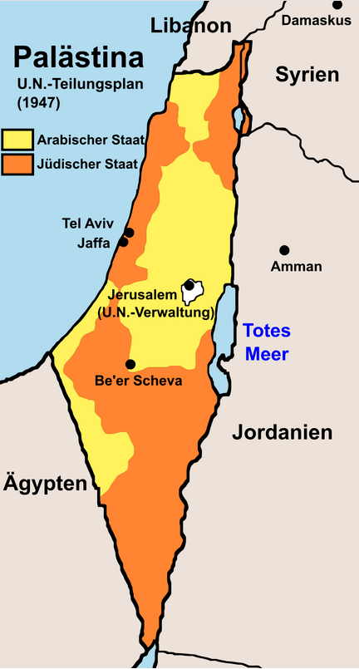
UN_Partition_Plan_For_Palestine_1947.svg: U.S. Central Intelligence Agencyderivative work: Furfur, Public domain, via Wikimedia Commons
https://upload.wikimedia.org/wikipedia/commons/3/3d/UN_Partition_Plan_For_Palestine_1947_de.svg

Slide 5
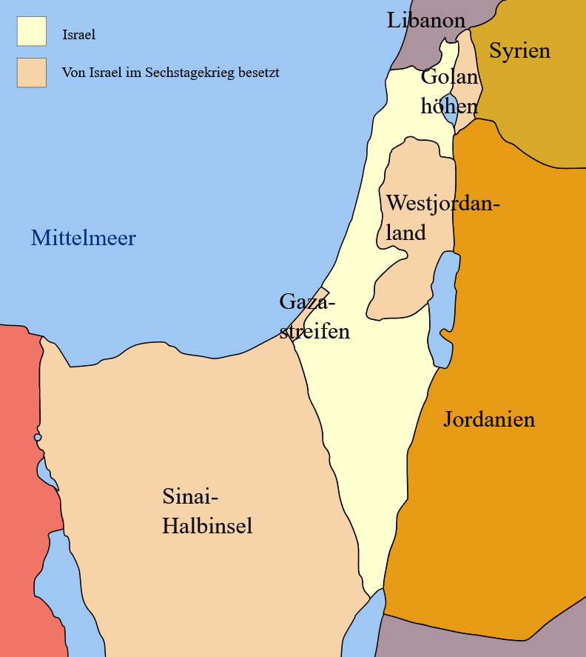
Six Day War Territories User:Ling.Nutderivative work: Rafyderivative work: KordasTranslated to german by Steinsplitter, CC BY-SA 3.0 creativecommons.org by-sa/3.0 via Wikimedia Commons
https://de.wikipedia.org/wiki/Nahostkonflikt

