Slide 1
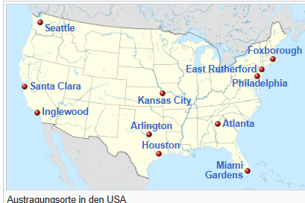
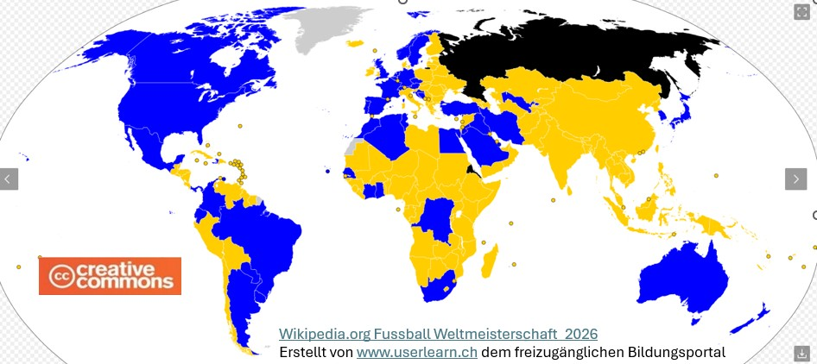
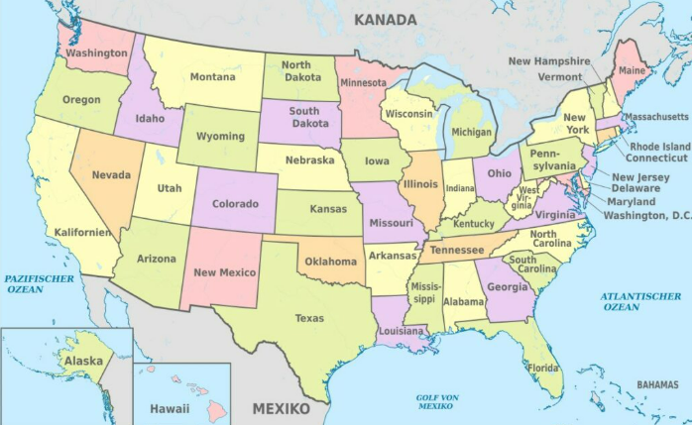
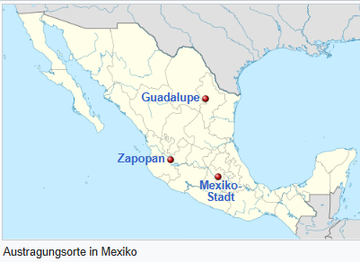
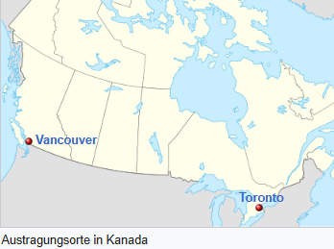
Yug und Tubs, CC BY-SA 2.5 https://creativecommons.org/licenses/by-sa/2.5, NordNordWest, CC BY 3.0 https://creativecommons.org/licenses/by/3.0, via Wikimedia Commonsvia Wikimedia Commons - Wikipedia

